Slide 1

Assessing the health impact of a major airport expansion in Singapore
Yaoding Chen
Nanyang Technological University, Singapore

Slide 2
Method Health impact assessment (HIA)
What is HIA?
A scheme to identify potential health impact resulted from a public policy or other decisions, especially how such decisions affect those who are vulnerable or disadvantaged.
Why we need HIA?
If we need to critically evaluate the health impact of a specific programme or project, then HIA should be introduced, especially it involves great public health interests
Sustainable development of a project or a programme is only possible with healthy populations. And HIA helps us find ways to achieve population health and sustainable development

Slide 3
Method US CDC framework of health impact assessment (HIA)
We use US Centre for Disease Control and Prevention (CDC)’s approach to HIA:
Screening > Scoping > Assessment > Recommendations > Reporting > Monitoring & Evaluation
Why we use this approach?
The approach contains well-rounded consideration of recommendations and how to address recommendations to different shareholders than the WHO approach
Also, each step is more clearly defined and is easy to follow.
Besides, there are more research using the scheme, which helps international comparison of similar research

Slide 4
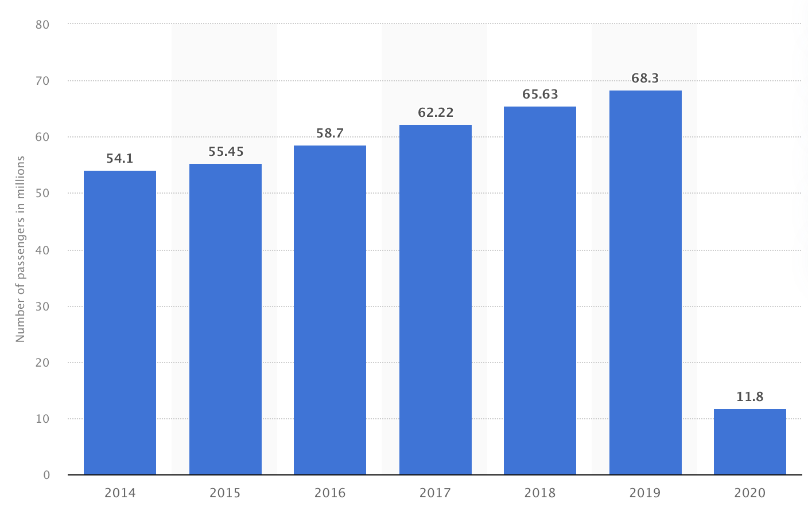
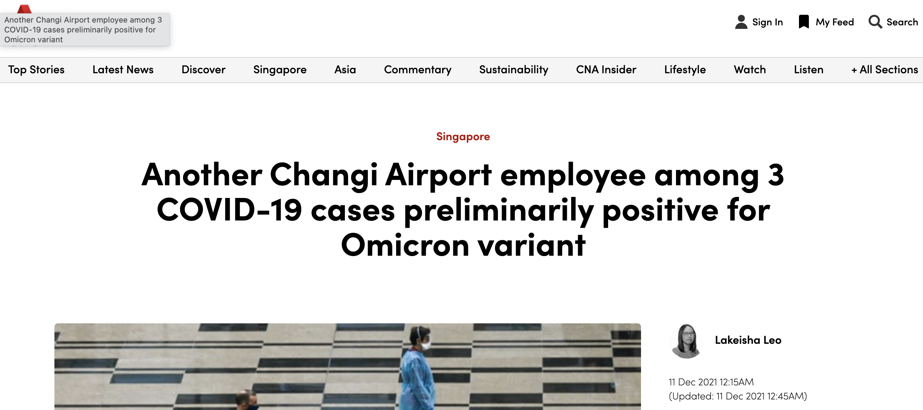
Screening Introduction to Changi Airport
Changi Airport is Singapore’s sole commercial international airport
8 years as the world’s best airport before 2021 according to Skytrax
Heavily hit by Covid-19 in term of both local and international visitors
Infectious disease control raised as a public health concern related to the airport
The number of passengers in millions at Changi dropped in 2020, indicating heavy hit by the Covid-19 pandemic
Local news report on Changi Airport employees among the first to be tested positive for Omicron variants in Singapore

Slide 5
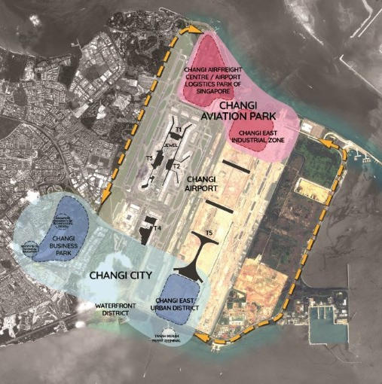
Screening Introduction to Changi East Project
Project launched in 2014
3rd runway finished in 2020
Terminal 5 construction and the rest paused in 2021 due to uncertainty caused by Covid-19
No health impact assessment ever done before, suggesting urgent need to do so

Slide 6

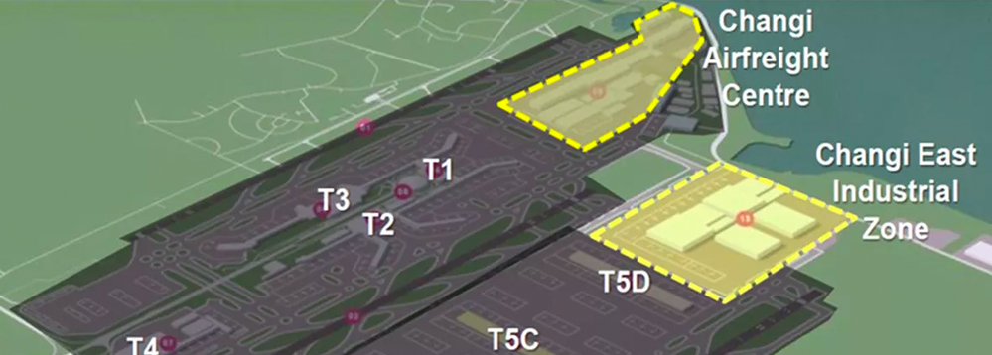
Scoping Potential health impact by Changi East
Local news report on Changi Airport employees among the first to be tested positive for Omicron variants in Singapore
Infectious diseases such as Covid-19 to put employees and public health in danger
Increased noise level due to more jet flyovers
Debris and wastewater from the new industrial
Local news report on Northeast Singapore suffering from jet noise
Masterplan shows an industrial zone to be built within Changi East

Slide 7
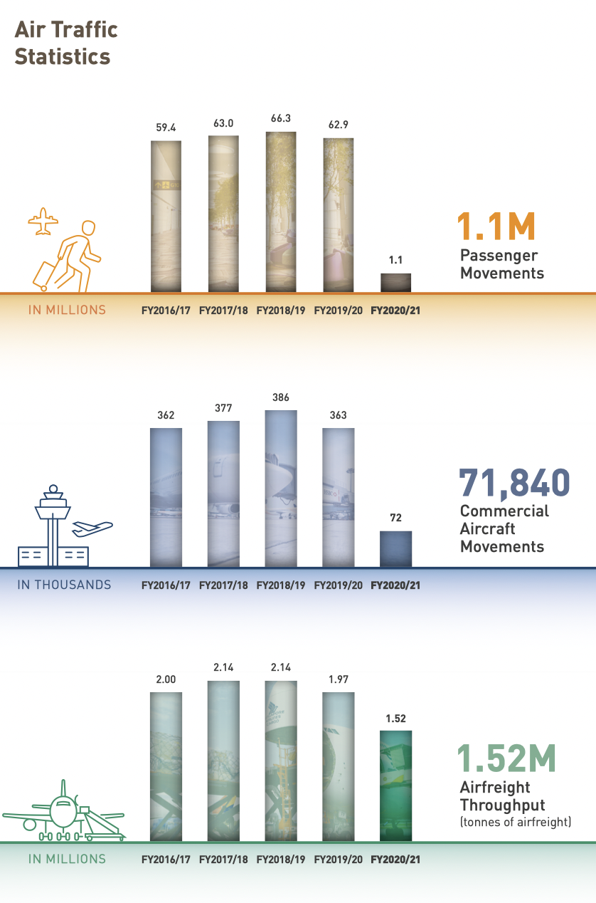
Assessment Population impacted by infectious disease control
International travellers through Changi on in-/outbound flights
1.1M/yr
Local land travellers through Changi via public transport > 700k/day
Airport employees = 1,800
Industrial zone employees = N/A
Public transport drivers < 1000
Data from Changi Airport Group annual report

Slide 8
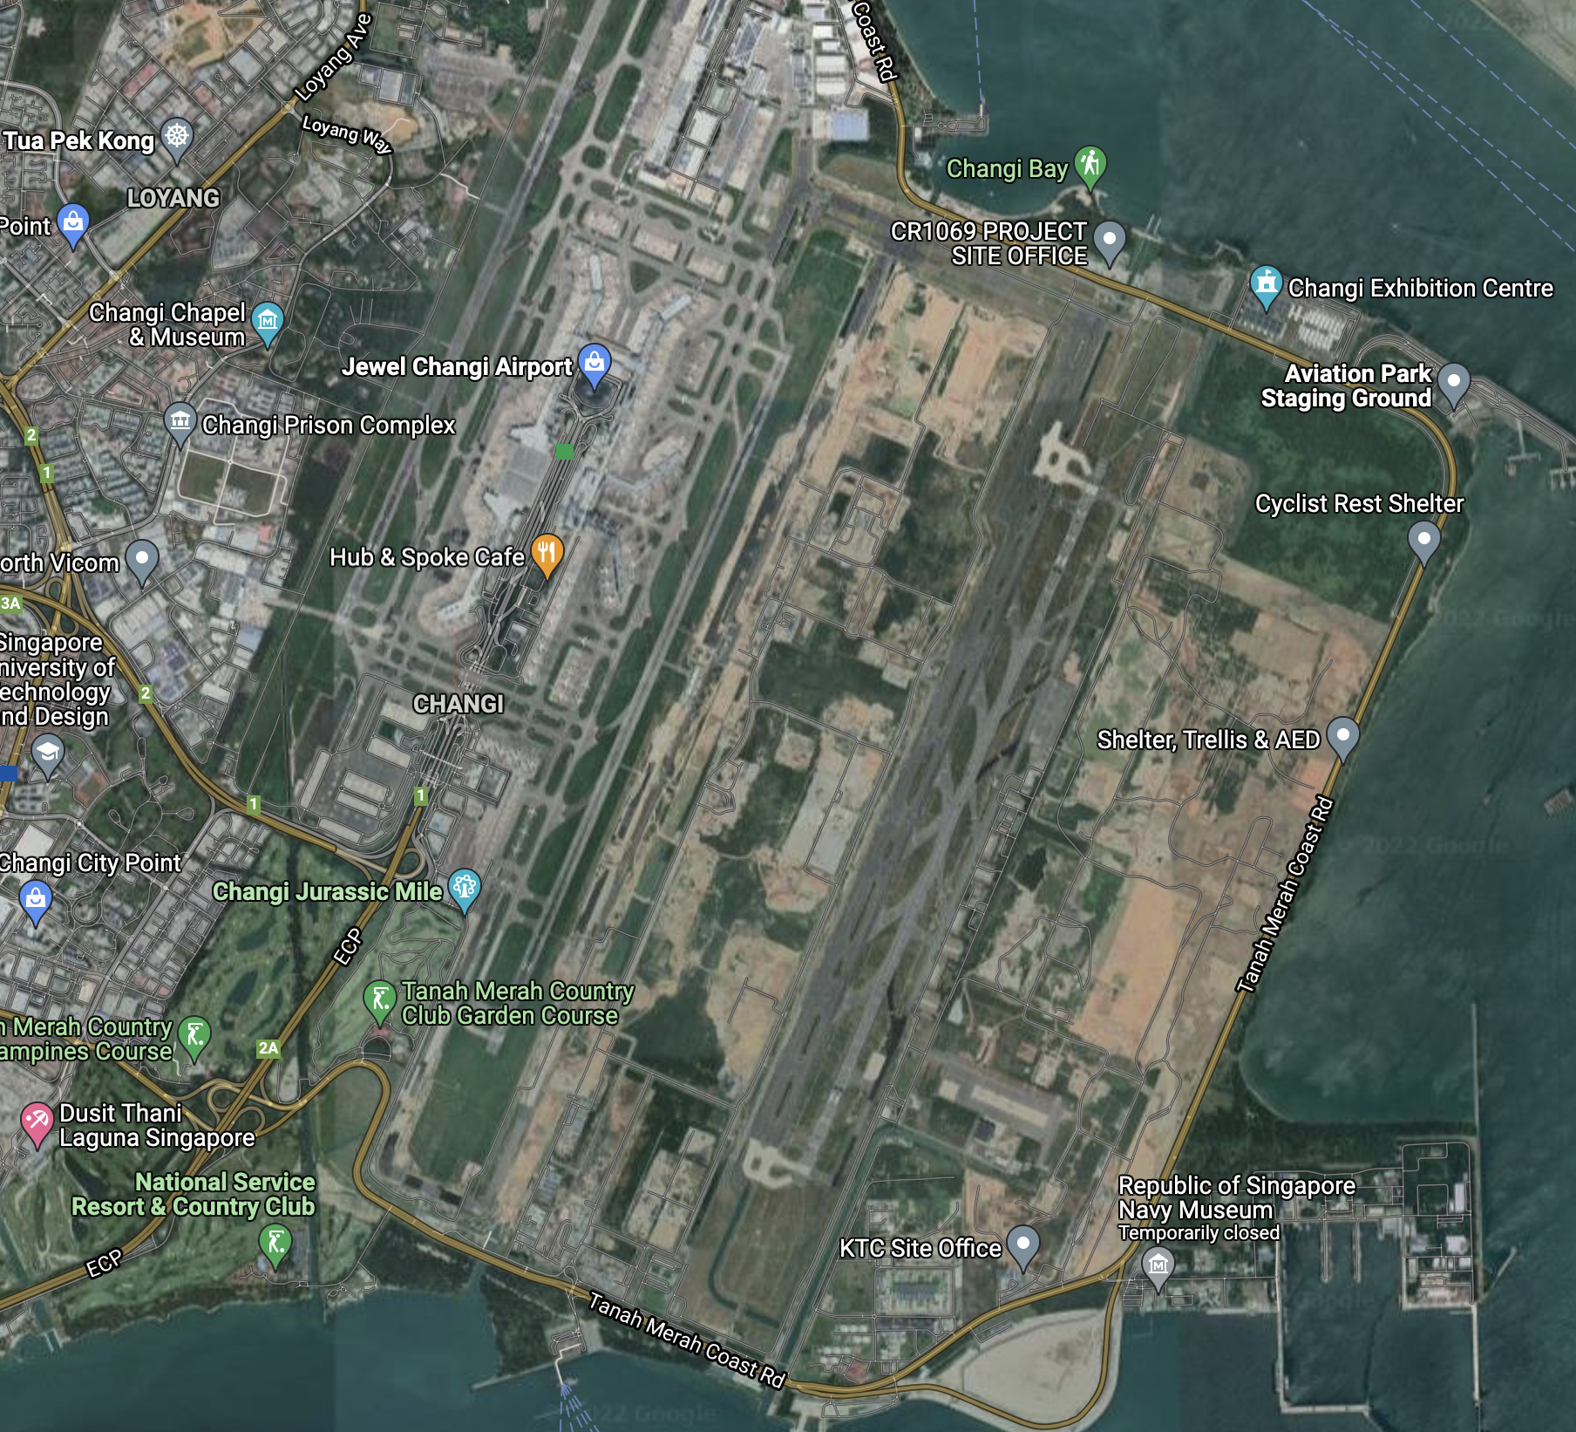
Assessment Populations impacted by jet noise
Northeast Singapore residents already impacted by the existing runways
Google map snapshot of Changi Airport
The existing airport zone is coloured yellow and the third runway is coloured in red

Slide 9
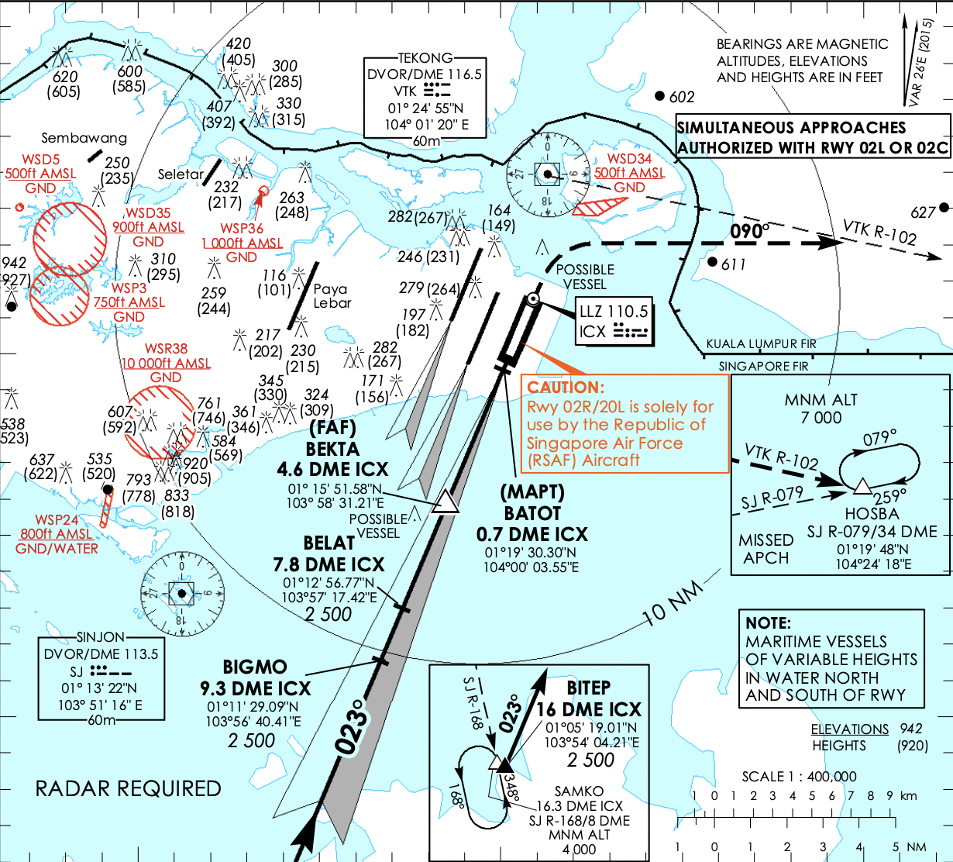
Assessment Populations impacted by jet noise
Northeast Singapore residents already impacted by the existing runways
Still landing of the third runway affect eastern half of Singapore, plus part of Kawasan, Malaysia
Using the third runway may reduce extreme noise but still cause much noise
Instrument approach chart of the third runway
Map from Civil Aviation Authority of Singapore

Slide 10
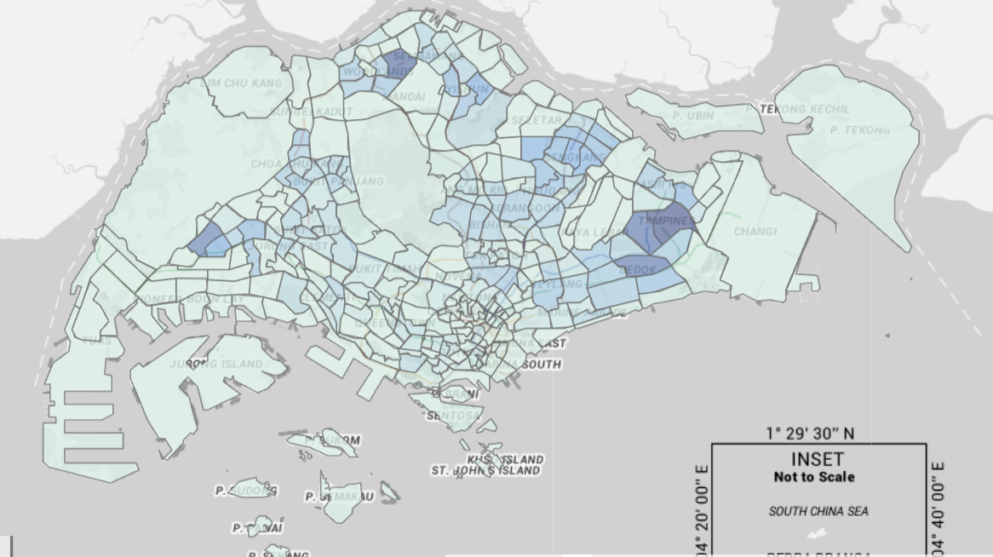

Assessment Populations impacted by jet noise
Northeast Singapore residents already impacted by the existing runways
Still landing of the third runway affect eastern half of Singapore, plus part of Kawasan, Malaysia
Consideration to expand the runway may need to be consulted by the majority
Affected regions among the most populated in Singapore
Eastern Region population
est. $>$ 686k
Population within the circle
est. $>$ 2M
Map and population data from Department of Statistics, Singapore

Slide 11
Recommendations In term of disease control
New industrial zone
Industrial Zone
Reconsider a buffer zone at the proposed Changi city to prepare for room for quarantine near the airport
All employees serving the airport should have enhanced training for public health and disease control
buffer
zone?
Waterfront business district
Map from Urban Redevelopment Authority

Slide 12
Recommendations In term of jet noise
New industrial zone
Noise-hit
Industrial Zone
Local residents
The industrial zone should have extra protection from jet noise for the workers
Noise shielding should be built for the proposed Waterfront district
Restrict night flight number and use 3rd runway at night to reduce noise
Third runway
Noise-hit
Waterfront business district
Map from Urban Redevelopment Authority

Slide 13
Reporting
New industrial zone
Noise-hit
Industrial Zone
Local residents
Local residents, potential users of the industrial zone, and the employees serving the airport should be included for project rehearsal
Reports of HIA should be published and publicly available for the local residents to know
Third runway
Noise-hit
Waterfront business district
Map from Urban Redevelopment Authority

Slide 14
Evaluation
New industrial zone
Noise-hit
Industrial Zone
Local residents
Noise measurement networks should be built near the airport for noise monitoring
Workers in the region should be surveyed for noise control and disease control measures
Third runway
Noise-hit
Waterfront business district
Map from Urban Redevelopment Authority

